Slide 1



How to use the Experimentation Facility

Slide 2
Table of Contents
Introduction
Equipment
Technical Specification
Implementation
Questions
Conclusion

Slide 3
Introduction - Experimentation Facility
What is the Experimentation Facility?
The ZDMP experimentation facility (based in Tampere University, Finland) provides a physical environment to study and freely experiment with ZDMP components (zComponents) and ZDMP Applications (zApps) to ascertain their functionalities and capability to ensure zero defects in manufacturing
It is an industrial environment that focusses on factory automation systems, intelligent manufacturing systems, and human-robot collaboration, thereby facilitating the testing, validation, and integration of ZDMP components and applications
A video of the experimentation facility: https://www.youtube.com/watch?v=F3EOUiNrCQo

Slide 4
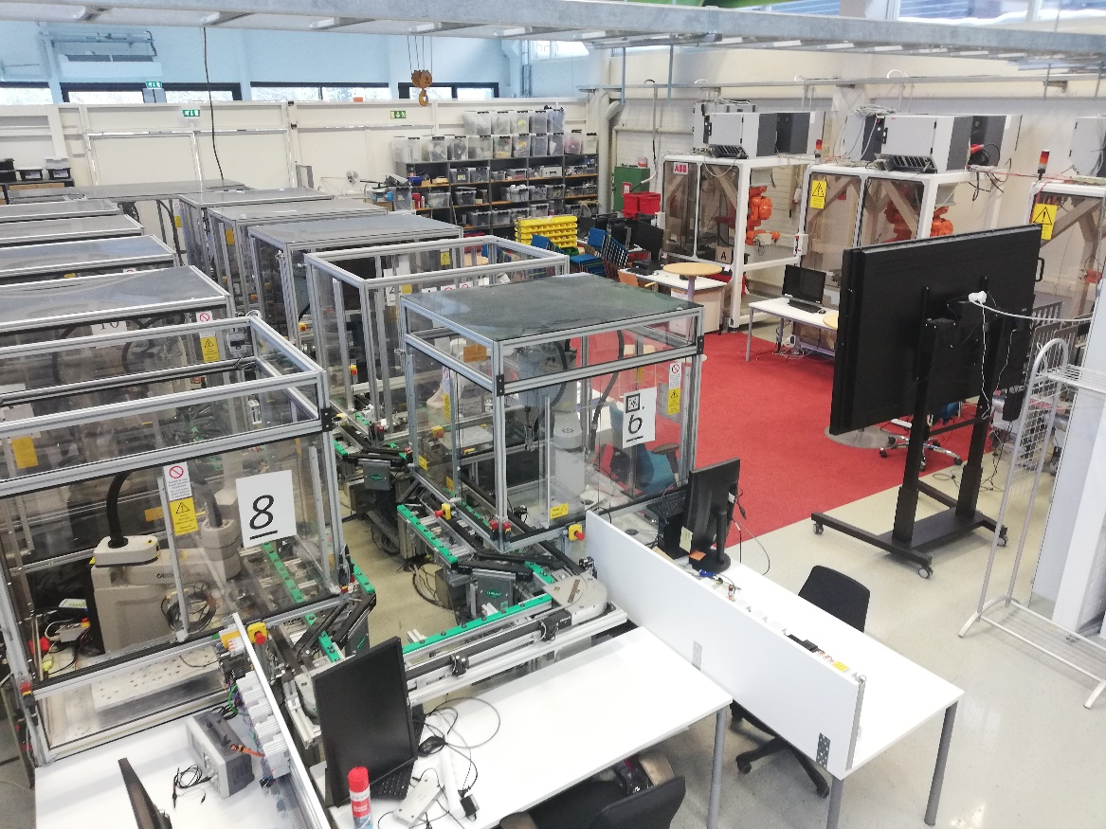
Introduction - Experimentation Facility
The experimentation facility consists of the following equipment and machines:
FESTO MPS Assembly Line
FASTory Assembly Line
EMCO Milling Machine
Portable Air Pressure Box
Mobile Industrial Robot (MiR100)
Omron Quattro Robot (4-axis parallel Robot)
ABB Yumi (Dual-Arm) Collaborative Robot
Industrial Communication Devices (Fieldbuses) – CANOpen, Profibus, Interbus, and Safety buses
Fig. 1: ZDMP Experimentation Facility

Slide 5
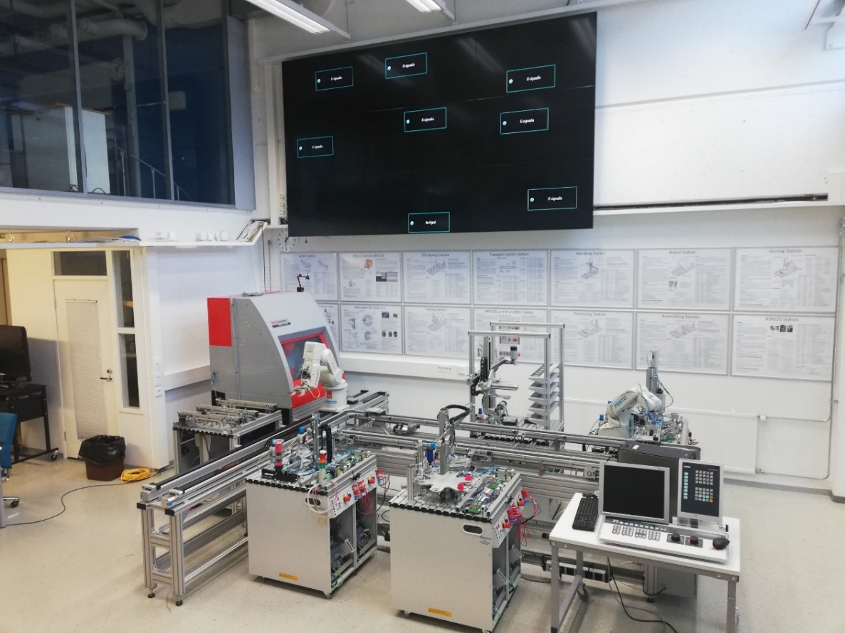
Equipment – FESTO MPS Assembly Line
The FESTO MPS Assembly Line demonstrates the assembly of piston-cylinder assembly in an industrial environment. It consists of different stations which are all connected by a conveyor line. The stations are equipped with Siemens ET200sp (CPU1500) controllers and linked by Siemens industrial Ethernet network. It is connected to 11 PC workstations enabled for developing complete automation solutions (SCADA-PLC-Simulation)
FESTO Line video: https://www.youtube.com/watch?v=rO3PFBPshzs
Fig. 2: FESTO MPS Assembly Line
Notes:
This slide presents the main goal and also the mission of ZDMP …

Slide 6
Technical Specifications – FESTO Line
Features: 8 workstations equipped with ET200sp controllers, 2 Mitsubishi robots (with extended I/O modules), 1 CNC machine, Pneumatic network for actuator control, sensors (proximity, light, capacitive, inductive, optical etc), Safety perimeter radars by PILZ and PROFINET
Programming environment: TIA portal (Languages: Based on IEC 61131 – 3 standard)
Logical Controller: Siemens ET200sp distributed I/O modules
Networking :Siemens industrial Ethernet network
Supported Technologies: MQTT, OPCUA
Relevance to ZDMP use cases: Automotive and Electronic use case
Notes:
This slide presents the main goal and also the mission of ZDMP …

Slide 7
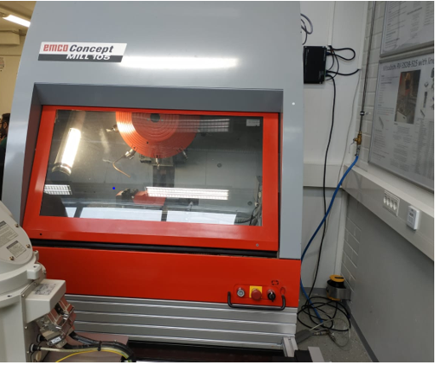
Equipment – EMCO Milling Machine
The EMCO Concept Mill 105 is a compact CNC desktop milling machine with a space for 10 tools on the spindle to perform different operations on workpieces like milling, thread milling, tapping, drilling etc. The EMCO milling machine is also integrated into Flexible Manufacturing Systems (FMS) through the robotics interface which controls peripheral equipment (e.g., automatic door) and connects the milling machine to other machines and devices. The milling machine is equipped with EMCO WINCC software solution for interchangeable control.
Fig. 3: EMCO Milling Machine

Slide 8
Technical Specifications – EMCO Milling Machine
Features: Tool turret with 10 stations (for tool change), Automatic door, Pneumatic unit for automatic door and pneumatic tailstock connection, high-resolution axis motors, portable machine operating panel
Software/Control: EMCO WINCC (for interchangeable control)
Relevance to ZDMP use cases: Machine Tool use case

Slide 9
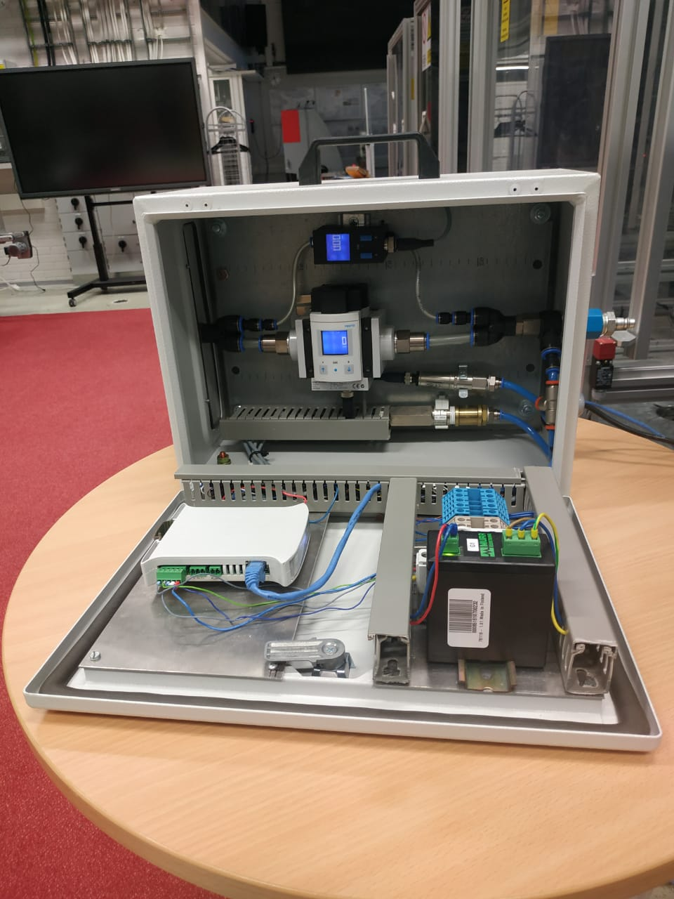
Equipment – Portable Air Pressure Box
Energy losses due to air leakage in pneumatic control systems is a common occurrence in factories across Europe. The portable air pressure box developed in FAST-Lab in Tampere University is utilized for measuring the air pressure supplied to the entire assembly lines. It provides information about air pressure drop resulting from any air leakage in the assembly lines. The air pressure box is also equipped with an INICO S1000 controller, which can be used to program device logic.
Fig. 4: Portable Air Pressure Box
Notes:
This slide presents the main goal and also the mission of ZDMP …

Slide 10
Technical Specifications – Air Pressure Box
Logical Controller: INICO S1000 controller
Supported Technologies: REST
Monitorable parameter: Air pressure (energy consumption)
Relevance to ZDMP use cases: Automotive and Electronic use case

Slide 11
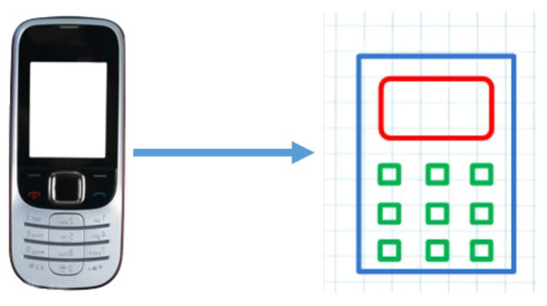
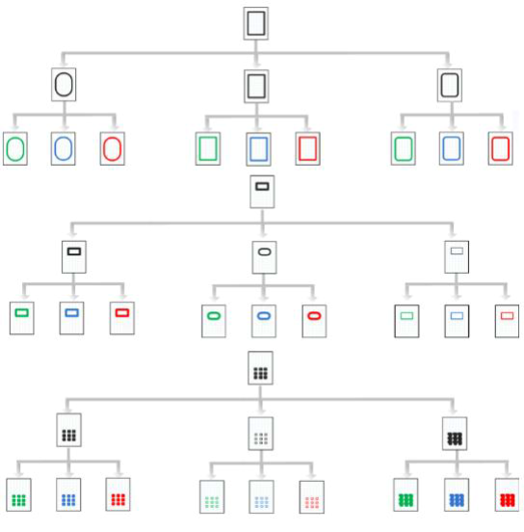
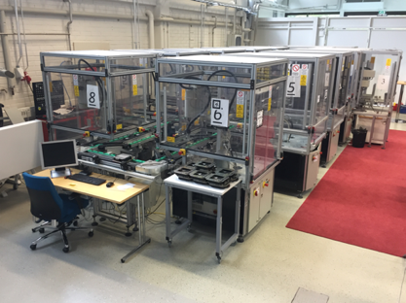
Equipment – FASTory Assembly Line
The FASTory assembly line demonstrates the assembly of mobile phones by drawing the main components (frame, screen, and keyboard) of three different phone models, with different colours and shapes on a sheet of paper carried by a pallet on a conveyor. This combination results in the production of 729 variants (i.e., 9 different screens * 9 different keyboards * 9 different frames). FASTory is equipped with INICO S1000 controllers
FASTory Line video: https://www.youtube.com/watch?v=zjCIYvvfOtI
Fig. 5a: FASTory final product
Fig. 5b: Variations of FASTory line product
Fig. 5c: FASTory Assembly Line
Notes:
This slide presents the main goal and also the mission of ZDMP …

Slide 12
Technical Specifications – FASTory Line
Features: 10 workstations, 10 robots (including Omron, ABB, Kuka, Sony and FANUC robots), pneumatic network for actuator control, different sensors, conveyor (main and bypass), energy meters
Development framework: Flask, NodeJS, Java
Logical Controller: INICO S1000 controller
Networking: Ethernet network
Supported Technologies: REST
Relevance to ZDMP use cases: Automotive and Electronic use case
Notes:
This slide presents the main goal and also the mission of ZDMP …

Slide 13
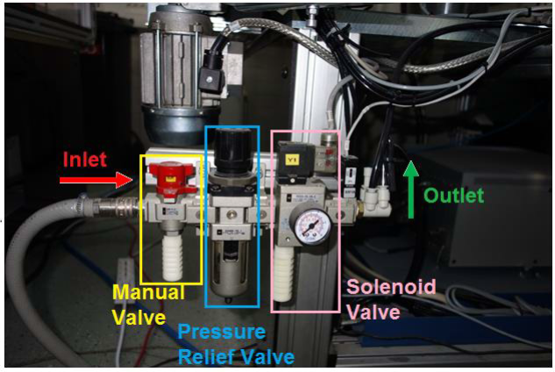
Technical Specifications – FASTory Line Components
Pneumatic System: The FASTory Line requires air pressure to work properly. The air pressure is used to actuate the track selector in the conveyor and the end effector in the robots. Thus, each work cell has a manual valve, pressure relief valve and solenoid valve as shown in Figure 6.
Fig. 6: FASTory Line Pneumatic system
Notes:
This slide presents the main goal and also the mission of ZDMP …

Slide 14
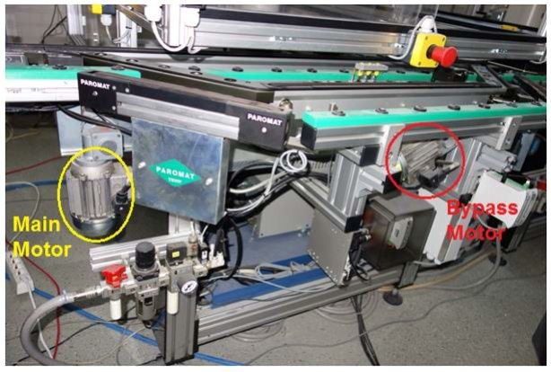
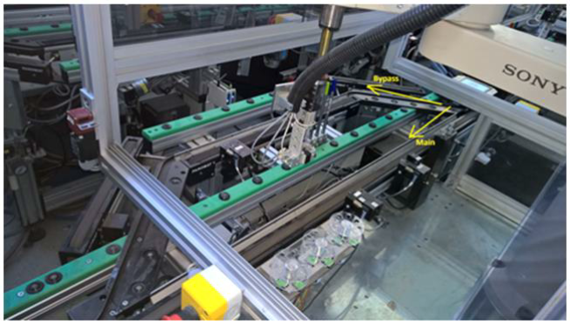
Technical Specifications – FASTory Line Components
Conveyors: Each workstation in the FASTory line consist of two conveyors; main and bypass. The main conveyor is used if the pallet requires service from the work cell. Meanwhile, the bypass is used if the work cell is in busy state (another pallet(s) [max 2 pallets] are in the cell) to bypass the pallet to the next work cell. See Figure 7. Both Conveyors (Main and Bypass) are controlled by a single RTU.
Fig. 7a: Conveyors motors
Fig. 7b: Conveyor direction

Slide 15
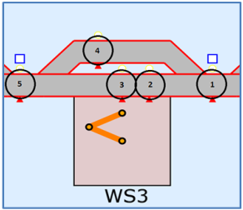
Technical Specifications – FASTory Line Components
Conveyors: As shown in Figure 8, each conveyor in FASTory line is divided into different zones. There are five different types of zones. In each zone, there is one presence sensor that is used for detecting the pallet presence. In addition, there is one stopper to stop the pallet when the conveyor is transferring other pallets. An RFID reader is located in “Zone 1 (Z1)” of each workstation. This reader reads the pallet’s tags for identifying the entering pallet.
Fig. 8: FASTory conveyor zones

Slide 16
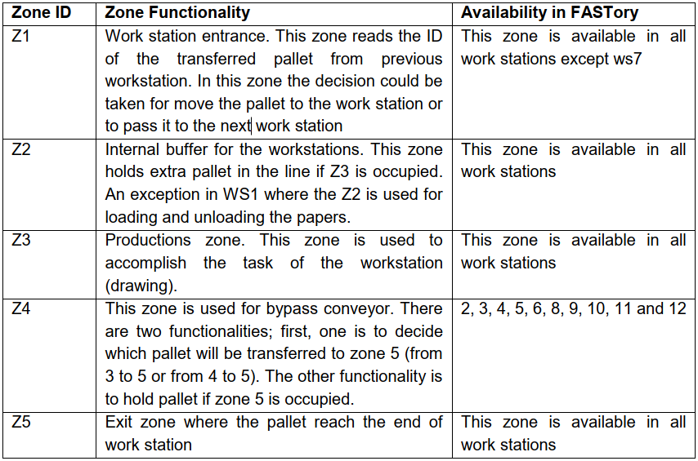
Technical Specifications – FASTory Line Components
Conveyors: Table 1 shows the functionality of these zones
Table 1: Zones functionality of the conveyor in the FASTory line

Slide 17
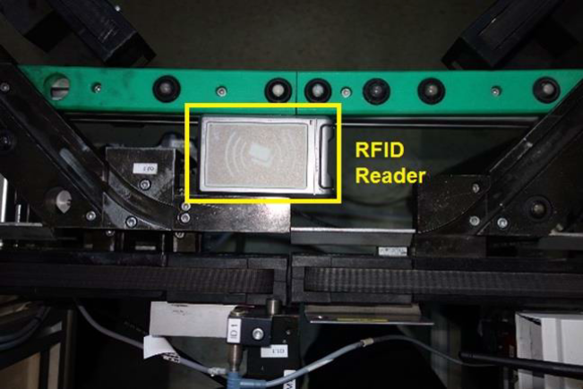
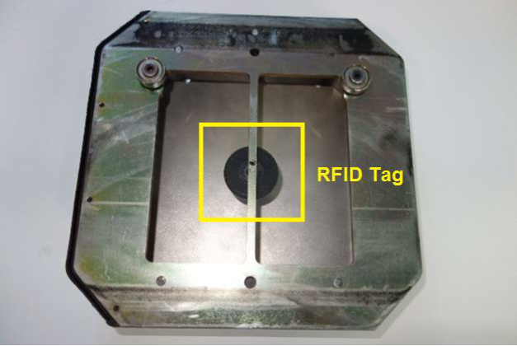
Technical Specifications – FASTory Line Components
RFID Readers: In order to identify the pallets in the line, The FASTory line is equipped with RFID reader (in each Z1) that can read the attached tags beneath the pallets. The reading mechanism uses the RS-232 serial communication by the conveyor RTU
Fig. 9a: RFID reader
Fig. 9b: RFID tag

Slide 18
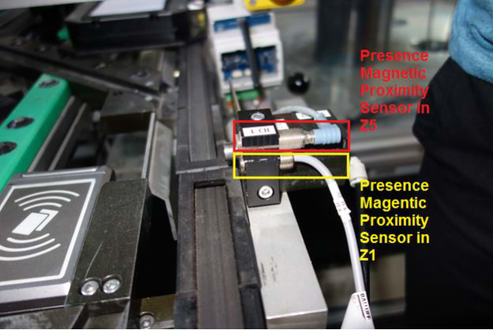
Technical Specifications – FASTory Line Components
Sensors: Each zone in the conveyor has a presence magnetic proximity sensor to detect the presence of pallets. Figure 10 shows the sensors in Z1 and Z5.
Fig. 10: The magnetic proximity sensors in Z1/Z5

Slide 19
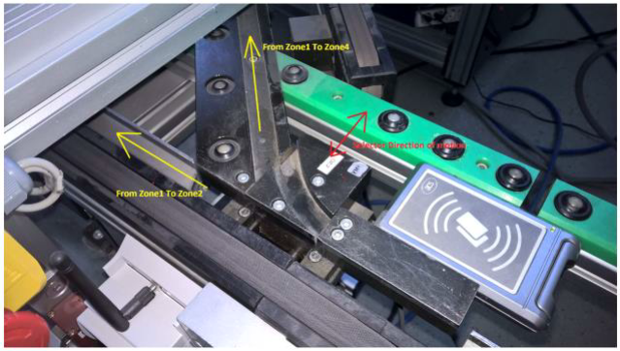
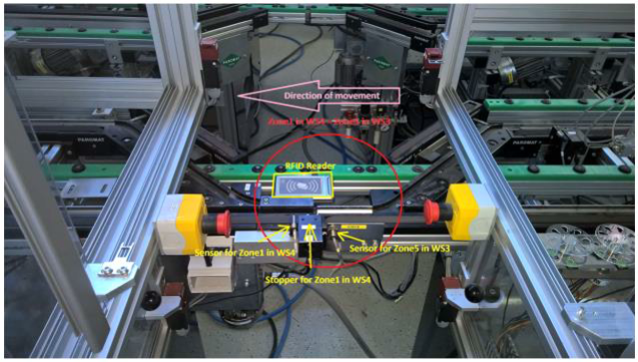
Technical Specifications – FASTory Line Components
Actuators: There are two pneumatic actuators; stoppers and path selector. Figure 11 shows both the stoppers and the selectors. The stopper stops the pallet in each zone. Meanwhile, the path selector switches between main and bypass conveyors.
Fig. 11a: Path selector in the conveyor
Fig. 11b: The stopper in Z1

Slide 20
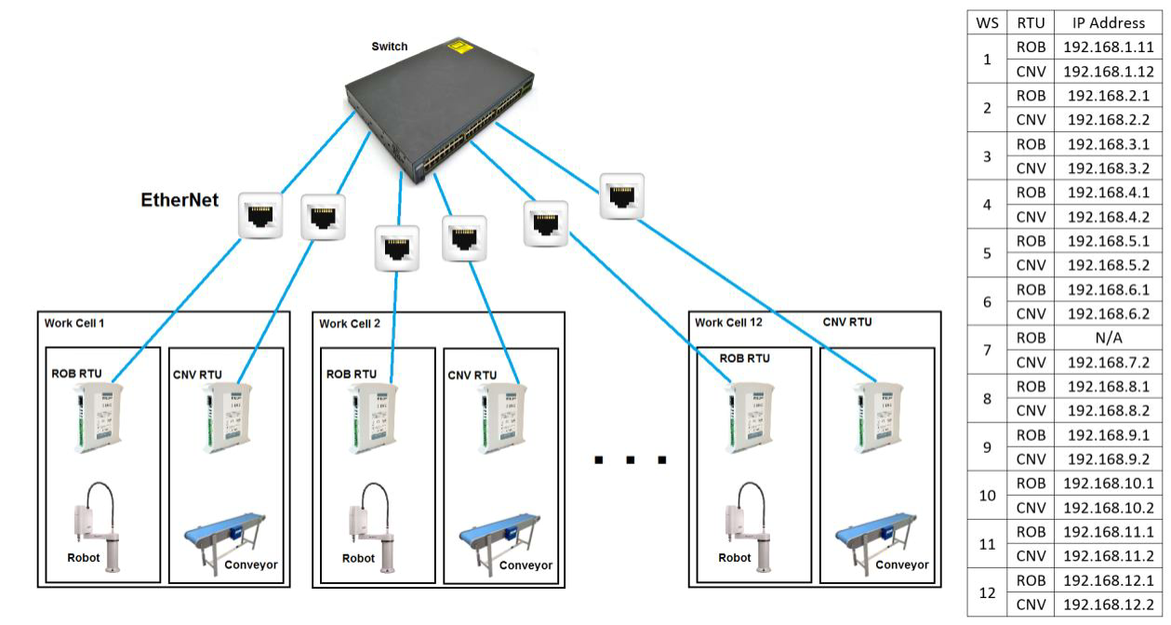
Technical Specifications – FASTory RTUs
The FASTory is equipped with INICO S1000 Remote Terminal Units (RTUs). INICO S1000 is a programmable RTU device, which offers process control capabilities, as well as a Web-based Human-Machine Interface (HMI), and it supports REST and DPWS Web Services. Each Robot and Conveyor is controlled by an RTU. The RTUs are connected to the FASTory local network as shown in Figure 12.
Fig. 12: FASTory network configuration
ROB: Robot
CNV: Conveyor
Notes:
This slide presents the main goal and also the mission of ZDMP …

Slide 21
Technical Specifications – FASTory Line APIs
The FASTory line supports both RESTful and SOAP (DPWS) services. With RESTful web services, the user is able to invoke services (operation /query) on the RTU level. Besides, the user might get a feedback of the line by subscribing the specific events in the RTU level.
Services:
In order to read the services description hosted by the RTUs, the user should request the following RESTful service:
GET: {hostIP}/rest/services
Then, using the web links, the user can read the services as children of the RTU services. The self link in each service is the one that the user can request. The http method (POST, GET) is defined by the class attribute. For the operation class, the user should use POST method, while query class represents the GET method

Slide 22
Technical Specifications – FASTory Line APIs
Services:
For operations, the user could use the following body if the user waits for confirmation message about the finished operation:
{“destUrl”:”http://example.com”}
In this manner, the RTU will send an empty POST request to the provided destUrl informing about the finishing of the operation. As an example, a user has an application, which invokes “TransZone12” (i.e., transfer pallet from zone 1 to zone 2) operation in workstation 6. The request should be like:
POST: http://192.168.6.2/rest/serives/TransZone12
Body:{“destUrl” : “http://192.168.123.123:8080”}

Slide 23
Technical Specifications – FASTory Line APIs
Services:
If the request is correct, then the RTU will respond to this request with 202. After that, the user’s application will receive a POST request on http://192.168.123.123:8080 with empty body. There should be the Application having 8080 port opened and waiting to receive the responses. After the response arrives, it can be processed by the Application. All FASTory RTUs services can be found in the Tables on the next slides.

Slide 24
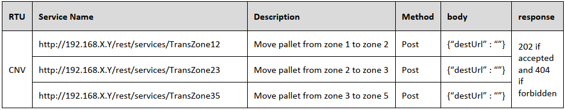
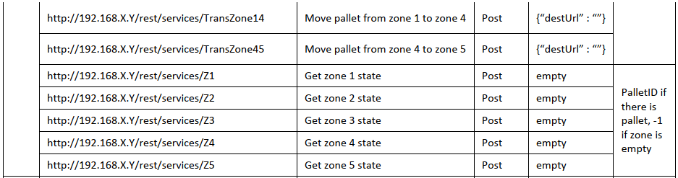
Technical Specifications – FASTory Line APIs
Services: (For Conveyors)
Table 2: RESTful APIs for the hosted services in the FASTory Line (Conveyors)

Slide 25
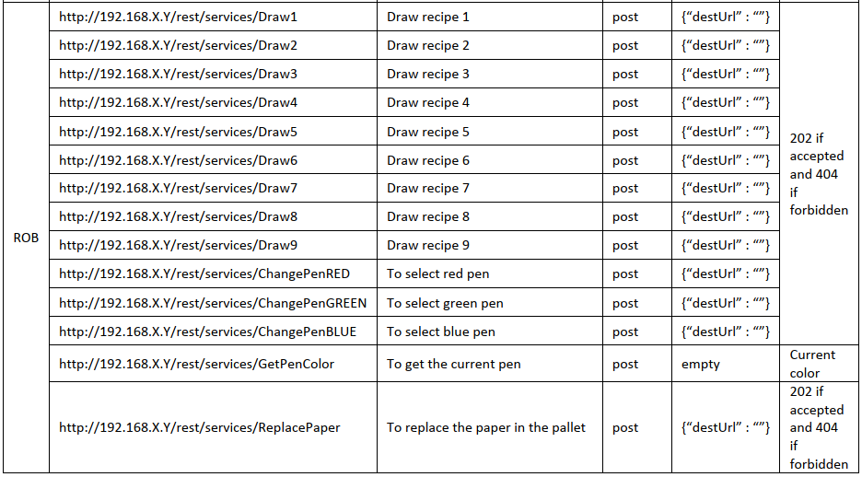
Technical Specifications – FASTory Line APIs
Services: (For Robots)
Table 3: RESTful APIs for the hosted services in the FASTory Line (Robots)

Slide 26
Technical Specifications – FASTory Line APIs
Events:
Another feature of the RTUs in the FASTory line is the event notification capability. Similarly, to the services, the user can read all possible notification in each RTU via the following request:
GET: {hostIP}/rest/events
All notification events are listed as JSON. The user subscribes to an event as follows :
POST: {hostIP}/rest/events/{eventID}/notifs
Body:{“destUrl” : “http://example.com”}

Slide 27
Technical Specifications – FASTory Line APIs
Events:
Once the Application of the user subscribes to an event, the application will receive notification as POST request with a JSON body. As shown below, the notification contains the event Id, the RTU Id and the payload. The payload contains the information about the event:
{
Id: "{EventID}",
senderID: "{RTUID}",
lastEmit: "",
payload:
{
}
}

Slide 28
Technical Specifications – FASTory Line APIs
Events:
As an example, an application needs to subscribe to Z2_Changed event in CNV8.
POST: http://192.168.8.2/rest/events/Z2_Changed/notifs
Body: {“destUrl” : “http://192.168.123.123:8080”}
Then once a pallet reaches or leaves Z2 in the CNV8, the application will receive a notification informing about the change of the zone status. All possible events in the FASTory line are listed in the Table on the next slide.

Slide 29
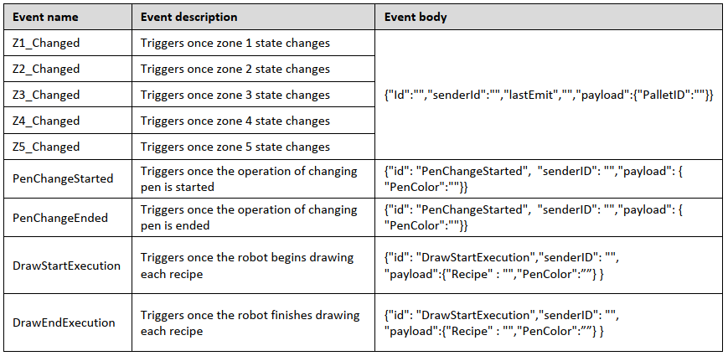
Technical Specifications – FASTory Line APIs
Events:
Table 4: All Events that can be triggered in the FASTory Line RTUs

Slide 30
Implementation (Example – FASTory Line)
How to run the FASTory Line
Step 1:
Connect to the FASTory line network
IP Address: 192.168.x.y (x and y must not be one of the defined ones for the RTUs)
Subnet Mask: 255.255.0.0
Step 2:
Turn the work cell ON by turning the main in the front panel switch clockwise. Then, press the push button in the front panel. At this moment, both the Robot and the conveyor RTUs are turned one, the Conveyor can be used but the Robot needs to be turned ON by turning the switch in the side panel clockwise. See images in next slide.

Slide 31
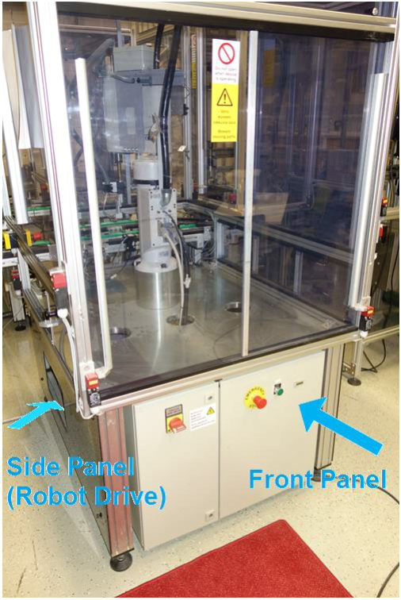
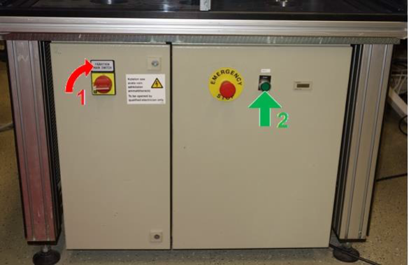
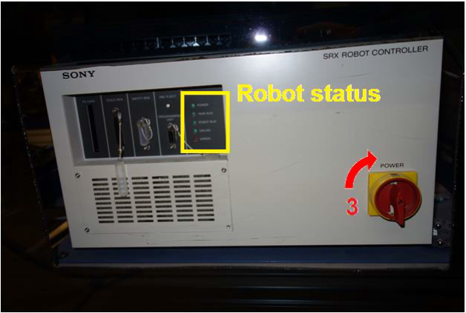
Implementation (Example – FASTory Line)
Once the robot turned ON, the status LEDs will be changed. In case of any error, it should be reported so maintenance can be performed
Fig. 13a: FASTory Work Cell
Fig. 13b: Front panel
Fig. 13c: Side panel

Slide 32
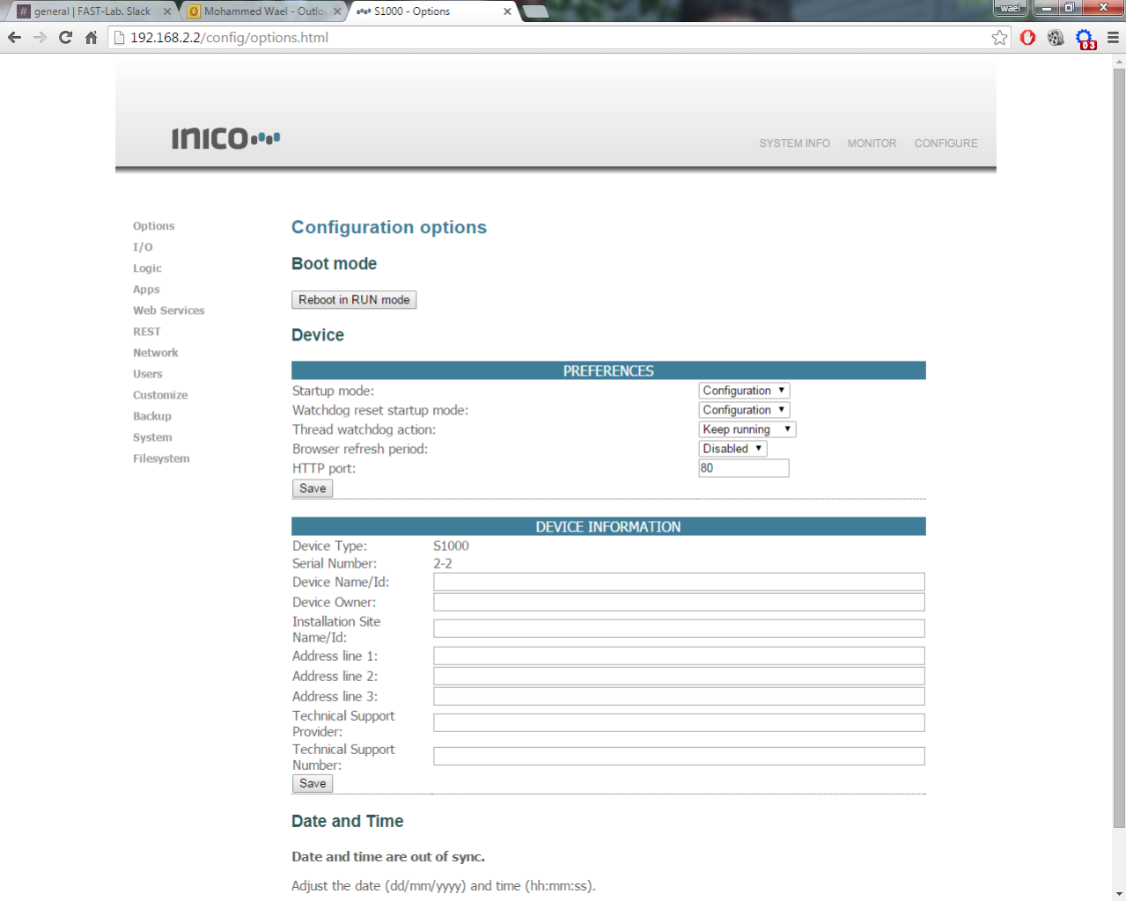
Implementation (Example – FASTory Line)
Step 3:
Go to the dedicated INICO page in Connect to the FASTory line network conveyor (192.168.z.x) and the robot (192.168.z.y) where x, y, and z can be seen in Figure 12. After that, the user can change the mode (config/run) of the RTU. See Figure 14.
Fig. 14: Configuration page in the RTU

Slide 33
Implementation (Example – FASTory Line)
Step 4:
Robot Calibration: The Robot can be calibrated by invoking the following service, using for example, Advanced REST Client.
POST: {HostIP}/rest/services/Calibrate
Headers: Content-Type: application/json
Body: {}
After invoking the calibration service as shown in Figure 15, the user should wait until the robot finishes (around 2 mins). During calibration, you may observe robot moving, unless robot was not already in the calibration position as the controller was turned on. In this manner, the calibration procedure is needed just once the robot drive is turned on. This is needed for each robot separately and then the Line is ready to be used

Slide 34
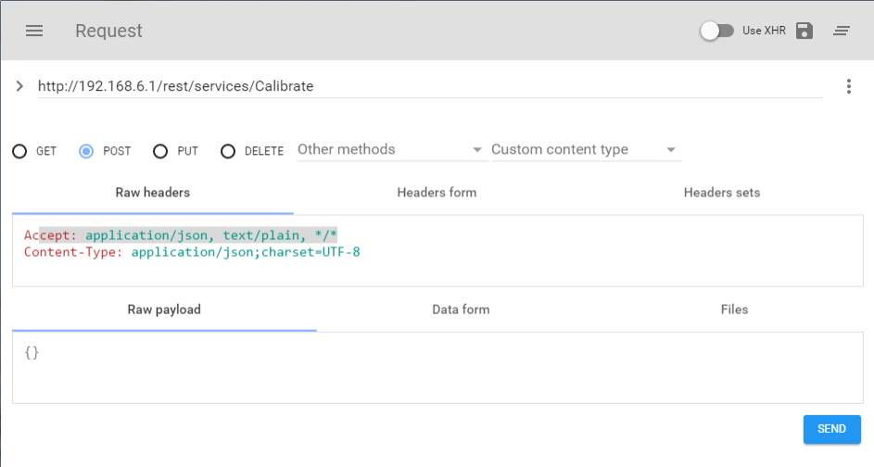
Implementation (Example – FASTory Line)
Fig. 15: Example of calibrating ROB6

Slide 35
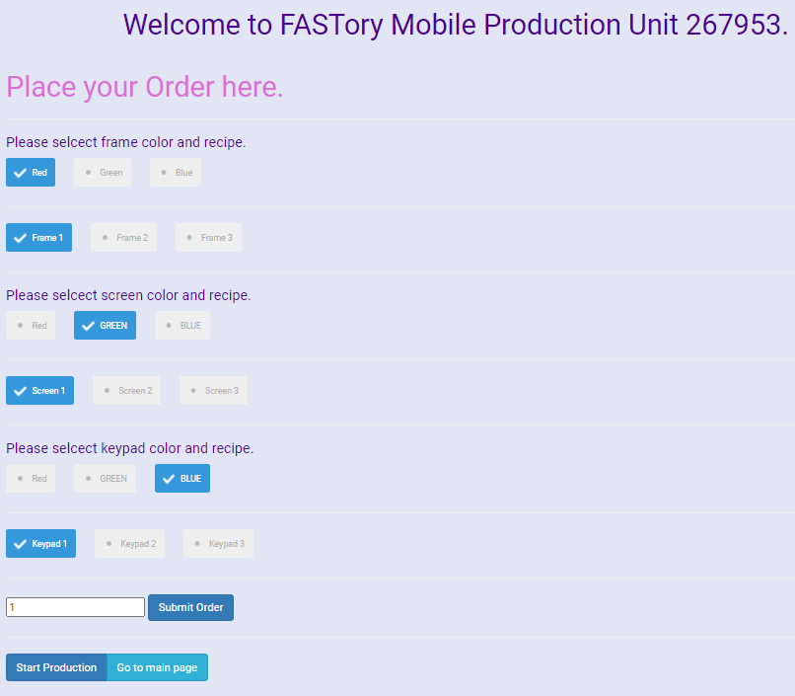
Implementation (Example – FASTory Line)
Mobile phone model selection (Ordering)
Steps:
The selection of the mobile phone model involves the selection and specification of the frames, screens and keypads in terms of their design and colour.
The selections can be made from the FASTory Line UI by clicking the desired combinations for the frame, screen and keypad as seen in Figure 16.
The information about the combinations are saved in the database
Fig. 16: Mobile phone model selection (Ordering process)

Slide 36
Implementation (Example – FASTory Line)
Mobile phone model selection (Ordering)
Steps:
The combinations selected in Fig. 16 results in a phone model of (Red frame of type 1, Green screen of type 1, and Blue keypad of type 1)
Click the “Submit Order” button to aggregate all the selections that has been made.
Click the “Start Production” button to commence the design process. The result of this is the invocation of the necessary “services (APIs)” provided by the FASTory Line to perform the Design operation.
In the case of the selections earlier made, the following services: {ChangePenRED, Draw1}, {ChangePenGREEN, Draw4}, and {ChangePenBLUE, Draw7} are invoked.
ChangePenRED -> Robot selects Red Pen (http://192.168.X.Y/rest/services/ChangePenRED)
Draw1 -> Robot draws Frame of recipe 1 i.e., model type 1 (http://192.168.X.Y/rest/services/Draw1)

Slide 37
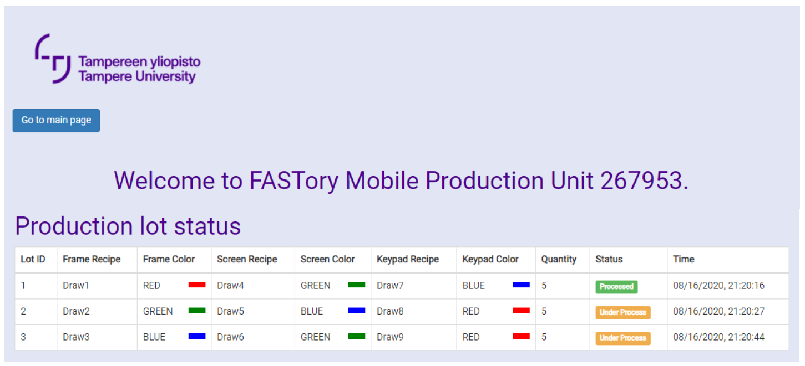
Implementation (Example – FASTory Line)
Mobile phone model selection (Ordering)
Steps:
While the design (drawing) operation is ongoing, the status of the order placed can be viewed on the FASTory Line UI as seen in Fig 17.
The combinations earlier selected can be seen represented with LotID 1. The “Processed” status shows that the order has been completed.
The “Under Process” status shows orders that are still under processing.
Fig. 17: Production Lot Status

Slide 38
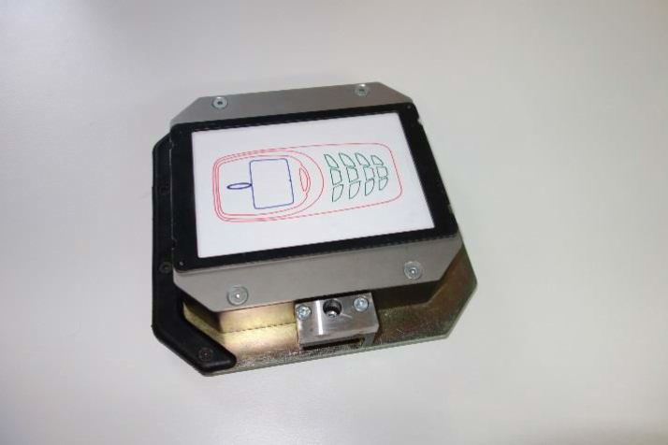
Implementation (Example – FASTory Line)
Mobile phone model selection (Ordering)
The final product is represented by Figure 18.
Fig. 18: Example of FASTory Line product

Slide 39
Questions
What are the objectives of the experimentation facility?
Testing and validation of zComponents and zApps (correct)
Integration of ZDMP solution (correct)
Product design
How many assembly lines are in the experimentation facility?
1
2 (correct)
3
Which of the following services represents pallet movement from zone 1 to zone 2?
http://192.168.X.Y/rest/services/TransZone12 (correct)
http://192.168.X.Y/rest/services/TransZone21
http://192.168.X.Y/rest/services/TransZone23
Notes:
In this slide some questions are asked to …

Slide 40

ZDMP – Conclusion
With the variety of equipment in the experimentation facility, it provides an environment for studying and experimenting several ZDMP components to ascertain their zero-defect functionalities.
The experimentation facility facilitates testing, validation and integration of ZDMP components.
The experimentation facility supports the Industry 4.0 concept.
Notes:
This part presents some conclusions related to the various contents of this module …

Slide 41
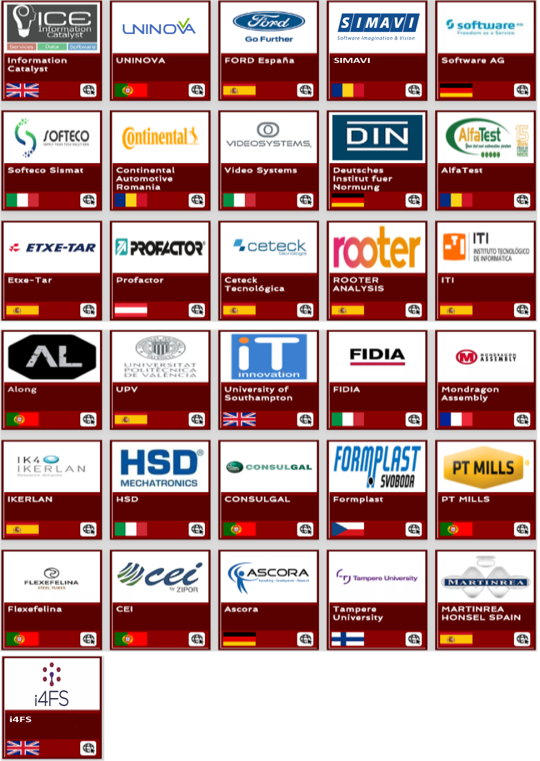
Thank You for watching
Funded by the Horizon 2020
Framework Programme of the European Union

